Slide 1

Project Title : Wireless AC Voltage Detector

Slide 2
Group Members:
AMMAR (FA19-BCE-001)
MUHAMMAD KALEEM ULLAH (FA19-BCE-007)

Slide 3
Context:
Objectives.
Principal.
Challenges.
Components.
Circuit Diagram.
Tests.
Applications.
Conclusions.

Slide 4
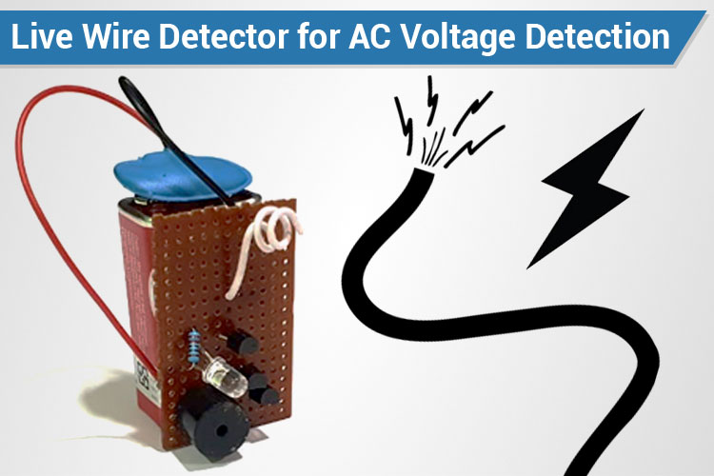
Objectives:
To Detect Voltage In A Wire Without Touching It.
To Detect, Is Wire Faulty? Or Any Damage Within Wire?
Notes:
In industries accident takes place due to leakage of electricity. The accidents can be avoided by using the wireless AC voltage detector

Slide 5
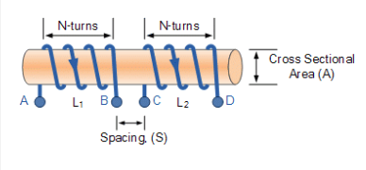
Principal:
Mutual Inductance
Mutual Inductance is the interaction of one coils magnetic field on another coil as it induces a voltage in the adjacent coil.

Slide 6
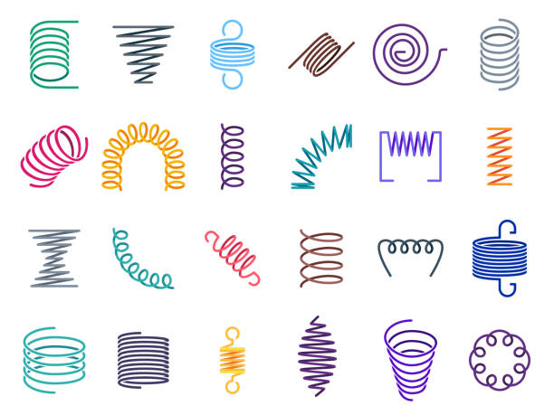
Challenges:
Weak Input Signal.
Calculation Of Parameters.
Selection Of Antenna
Notes:
To over come our weak signal problem, We have used the direct Ac voltages from the board you will see the tests videos. To over come Calculation of parameters problem we have used the dc voltages source of 1v and find the transistor working
Selection of antenna, we have used inamald wire used for winding

Slide 7
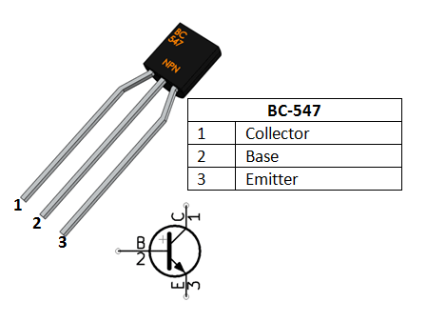
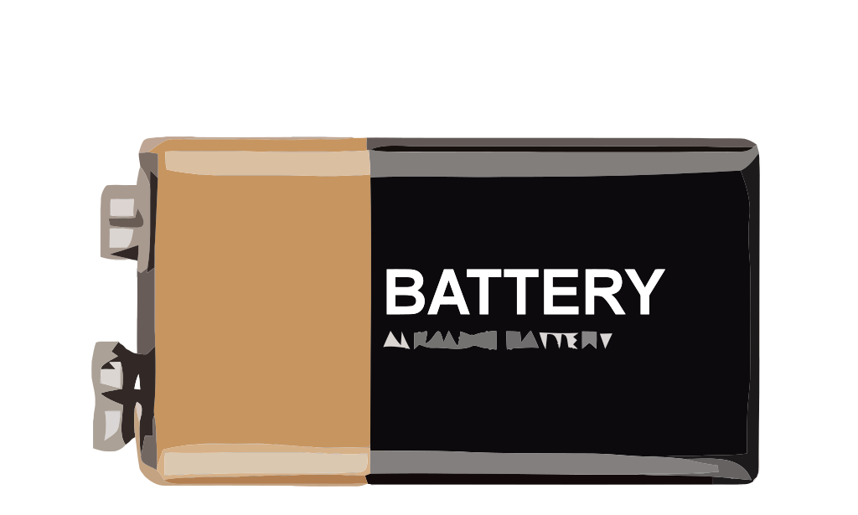
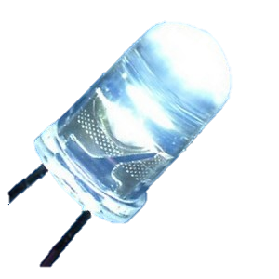
Components:
BJT NPN Transistor BC-547
Light Emitting Diode
9V Battery
Antenna

Slide 8
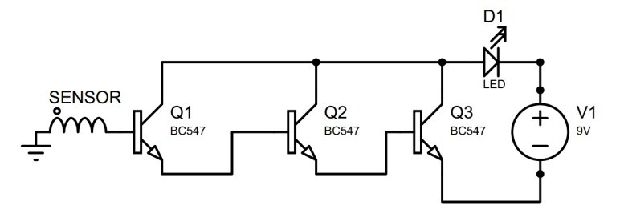
Circuit Diagram:

Slide 9
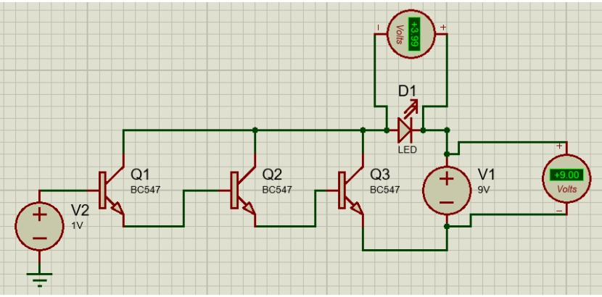
Simulation:
Notes:
As We Can See There Are 3 transistor being used with 2 sources and 1 led. The number of transistor is not fixed we can use any number we want the mre wo used the more signal get amplified and led glow better

Slide 10
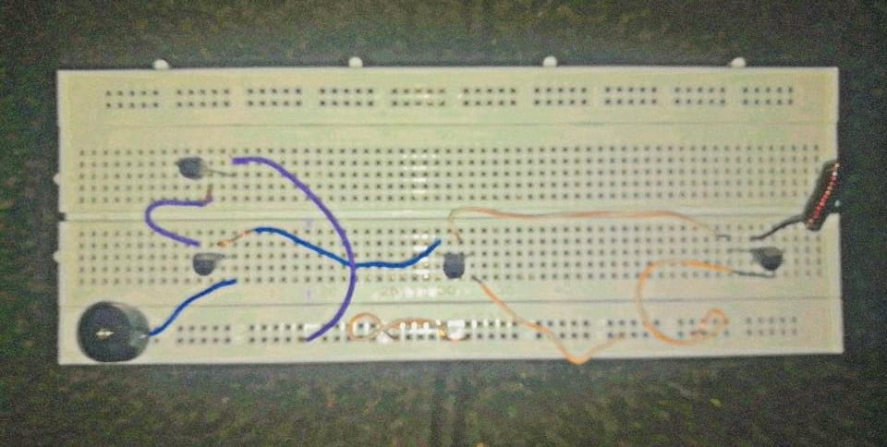
Hardware Implementation:
Notes:
Here Is the hardware implementation as we can see there is golden sensor when current caring wire is gets into its reach and it detect it electric field and provide inpute and them amplification process start

Slide 11
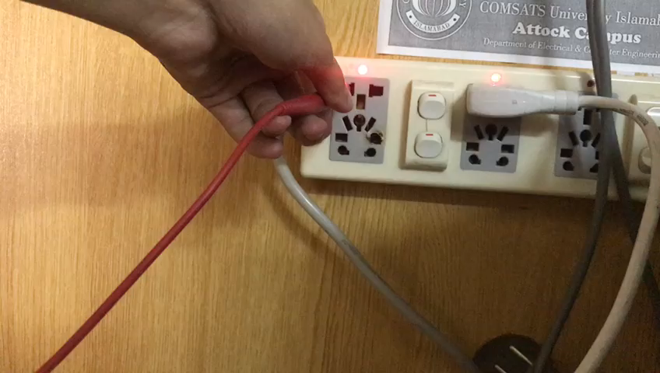
Test 1 :
Notes:
Here is test 1 where voltage is dectected wirlessly as per our objective we used direct volta

Slide 12
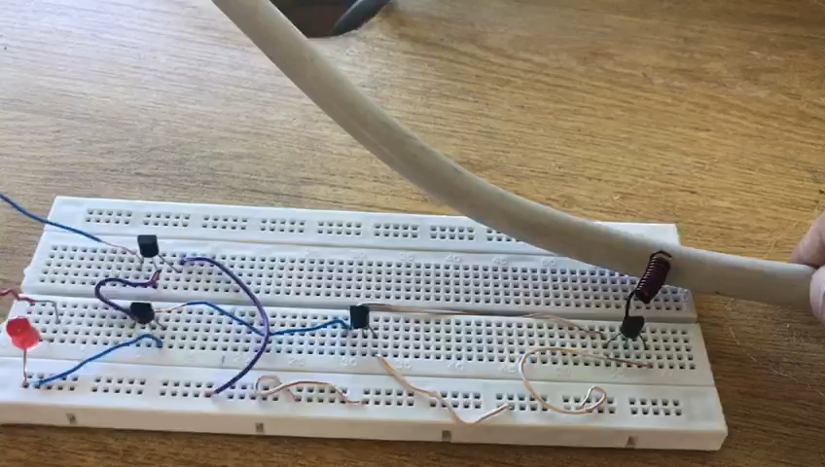
Test 2 :

Slide 13
Applications:
Useful To Trouble Shoot Wires.
Useful To Detect High Electric Field Areas.
Can Detect Presence Of Voltage Without Physical Contact.

Slide 14
Conclusions:
Working With Transistor.
Deal With Complexity Of Simulation And Practical Implementation.
Determine Practically Active, Saturation And Cut-Off Region.

Slide 15

Any Question ?

Slide 16
THE END

